Slide 1
CMPS 254
Threads
Management

Slide 2
Objectives
Differentiate Processes and threads
Manage threads using system calls

Slide 3
Threads
Thread: is a dynamic object (instance) that represents a control point in the process and executes a sequence of instructions.
An execution entity within a process
Thread is a mechanism that allows a program to do more than one thing at a time.
When you invoke a program, the operating system creates a new process and in that process creates a single thread, which runs the program sequentially.
That thread can create additional threads; all these threads run the same program in the same process, but each thread may be executing a different part of the program at any given time.
Notes:
Process has limitations: First, many applications wish to perform several largely independent tasks that can run concurrently, but must share a common address space and other resources. Example database management, and middle and upper-layer network protocols. These processes are parallel in nature . Another disadvantage is that processes cannot take advantage of multiprocessors architectures, these processes must find ways of sharing memory and resources and synchronizing their tasks with each other. Modern Operating systems address these problems by providing a variety of primitives to support concurrent processing called THREADS
A Thread is a dynamic object that represents a control point in the process and that executes a sequence of instructions.
The resources, which include an address space, open files , user credentials quotas are shared by all threads in the process. In addition, each thread has its private objects such as Program Counter, a Stack and a Register Context.
Reference: Uresh Vahalia, Unix Internals The New Frontiers,

Slide 4
Threads Resources
Threads in the same process share:
same address space.
Process instructions
Most data
open files (descriptors)
signals and signal handlers
current working directory
User and group id
Each thread has a unique:
Thread ID
set of registers, stack pointer
stack for local variables, return addresses
signal mask
priority
Return value: errno

Slide 5
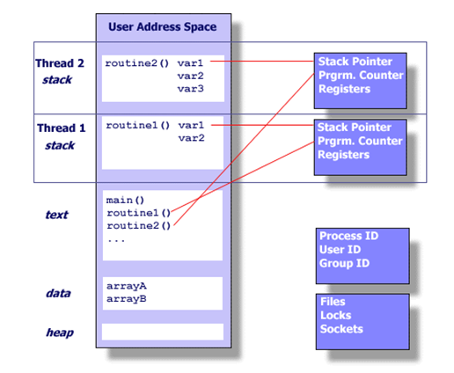
Threads

Slide 6
Hyper-Threading Technology
“Intel Hyper-Threading Technology (Intel HT Technology) was developed to improve the performance of IA-32 processors when executing multi-threaded operating system and application code or single-threaded applications under multi-tasking environments.”
“The technology enables a single physical processor to execute two or more separate code streams (threads) concurrently using shared execution resources.” From Intel document

Slide 7
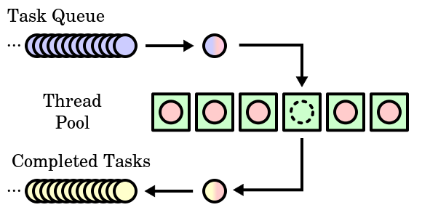
Thread Pool
https://en.wikipedia.org/wiki/Scheduling_(computing)#/media/File:Thread_pool.svg

Slide 8
Thread Operations
Thread operations include:
Thread creation,
Thread termination
Thread synchronization (joins, blocking)
Thread scheduling

Slide 9
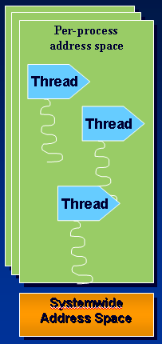
Windows Processes and Threads
Every process starts at least with one thread
Kernel creates initial thread with its stack and context
First thread executes the program’s “main” function
Can create other threads in the same process
Can create additional processes
Notes:
Although programs and processes appear similar on the surface, they are fundamentally different. A program is a static sequence of instructions, whereas a process is a container for a set of resources used when executing the instance of the program. At the highest level of abstraction, a Windows process comprises the following:
A private virtual address space, which is a set of virtual memory addresses that the process can use
An executable program, which defines initial code and data and is mapped into the process’s virtual address space
A list of open handles to various system resources, such as semaphores, communication ports, and files, that are accessible to all threads in the process
A security context called an access token that identifies the user, security groups, and privileges associated with the process
A unique identifier called a process ID (internally called a client ID)
At least one thread of execution

Slide 10
Windows Threads
Fundamental schedulable entity in the system
Represented by ETHREAD that includes a KTHREAD
Queued to the process (both E and K thread)
Unique thread ID
Associated User-mode Thread Environment Block (TEB)
User-mode stack
Kernel-mode stack
Processor Control Block (in KTHREAD) for CPU state when not running

Slide 11
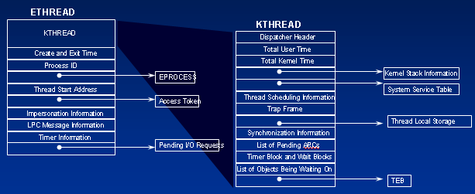
Thread Block

Slide 12
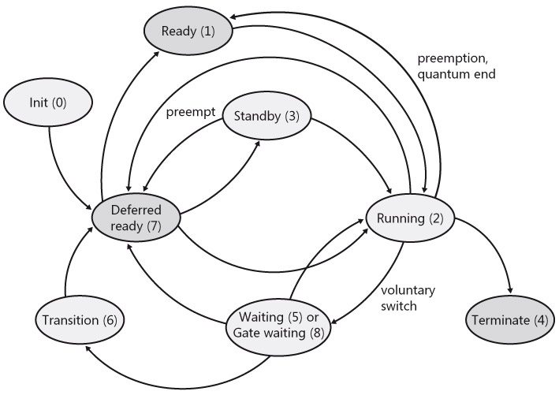
Windows Threads States
Notes:
The thread states are
Ready A thread in the ready state is waiting to execute. When looking for a thread to execute, the dispatcher considers only the pool of threads in the ready state.
Standby A thread in the standby state has been selected to run next on a particular processor. When the correct conditions exist, the dispatcher performs a context switch to this thread.
Running Once the dispatcher performs a context switch to a thread, the thread enters the running state and executes. The thread's execution continues until its quantum ends (and another thread at the same priority is ready to run), it is preempted by a higher priority thread, it terminates, it yields execution, or it voluntarily enters the wait state.
Waiting A thread can enter the wait state in several ways: a thread can voluntarily wait for paging I/O, or an environment subsystem can direct the thread to suspend itself. When the thread's wait ends, depending on the priority, the thread either begins running immediately or is moved back to the ready state.
Transition A thread enters the transition state if it is ready for execution but its kernel stack is paged out of memory. Once its kernel stack is brought back into memory, the thread enters the ready state.
Terminated When a thread finishes executing, it enters the terminated state. Once the thread is terminated, the executive thread block might or might not be dea-llocated.

Slide 13
Windows Thread APIs
CreateThread
CreateRemoteThread
GetCurrentThreadId - returns global ID
GetCurrentThread - returns handle
SuspendThread/ResumeThread
ExitThread
TerminateThread - no DLL notification
GetExitCodeThread
GetThreadTimes
Notes:
The following are the thread-related functions (the description of the mechanism behind system calls is in Unit OS2):
AttachThreadInput Attaches the input processing mechanism of one thread to that of another thread.
CreateRemoteThread Creates a thread that runs in the virtual address space of another process.
CreateThread Creates a thread to execute within the virtual address space of the calling process.
ExitThread Ends a thread.
GetCurrentThread Retrieves a pseudo handle for the current thread.
GetCurrentThreadId Retrieves the thread identifier of the calling thread.
GetExitCodeThread Retrieves the termination status of the specified thread.
GetThreadId Retrieves the thread identifier of the specified thread.
GetThreadIOPendingFlag Determines whether a specified thread has any I/O requests pending.
GetThreadPriority Retrieves the priority value for the specified thread.
GetThreadPriorityBoost Retrieves the priority boost control state of the specified thread.
GetThreadTimes Retrieves timing information for the specified thread.
OpenThread Opens an existing thread object.
ResumeThread Decrements a thread's suspend count.
SetThreadAffinityMask Sets a processor affinity mask for the specified thread.
SetThreadIdealProcessor Specifies a preferred processor for a thread.
SetThreadPriority Sets the priority value for the specified thread.
SetThreadPriorityBoost Disables the ability of the system to temporarily boost the priority of a thread.
Sleep Suspends the execution of the current thread for a specified interval.
SleepEx Suspends the current thread until the specified condition is met.
SuspendThread Suspends the specified thread.
SwitchToThread Causes the calling thread to yield execution to another thread that is ready to run on the current processor.
TerminateThread Terminates a thread.
ThreadProc An application-defined function that serves as the starting address for a thread.
TlsAlloc Allocates a thread local storage (TLS) index.
TlsFree Releases a TLS index.
TlsGetValue Retrieves the value in the calling thread's TLS slot for a specified TLS index.
TlsSetValue Stores a value in the calling thread's TLS slot for a specified TLS index.
WaitForInputIdle Waits until the specified process is waiting for user input with no input pending, or until the time-out interval has elapsed.

Slide 14
POSIX-Threads
Each thread in a process is identified by a thread ID. It uses the type pthread_t.
#include <pthread.h>
Upon creation, each thread executes a thread function.
This is just an ordinary function
and contains the code that the thread should run.

Slide 15
Creating a Thread (pthread_create)
The pthread_create function creates a new thread. You provide it with the following:
A pointer to a pthread_t variable, in which the thread ID of the new thread is stored.
A pointer to a thread attribute object. If you pass NULL as the thread attribute, a thread will be created with the default thread attributes.
A pointer to the thread function. This is an ordinary function pointer, type: (*) void*
A thread argument value of type void*. Whatever you pass is simply passed as the argument to the thread function when the thread begins executing.

Slide 16
pthread_create usage
int pthread_create (pthread_t * thread, const pthread_attr_t * attr, void * (*start_routine)(void *), void *arg);
pthread_create(&t1, NULL, print_msg, (void *) “hello”);

Slide 17
Thread Synchronization - Join threads
Linux schedules threads asynchronously, and your program must not rely on the relative order in which instructions are executed.
pthread_join function is a function similar to wait that waits for a thread to finish instead of a process.
pthread_join blocks the calling thread until the thread specified by thread terminates.
pthread_join returns 0 when the thread terminates.

Slide 18
pthread_join
pthread_join, takes two arguments:
The thread ID of the thread to wait for,
A pointer to a void* variable that will receive the finished thread’s return value.
If you don’t care about the thread return value, pass NULL as the second argument.

Slide 19
pthread_join usage
int pthread_join( pthread_t thread, NULL)
pthread_join(t1, NULL)

Slide 20
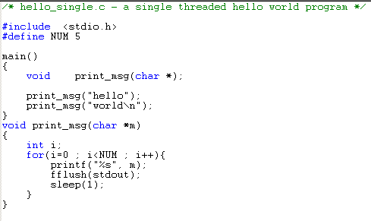
Single Thread program (process)

Slide 21
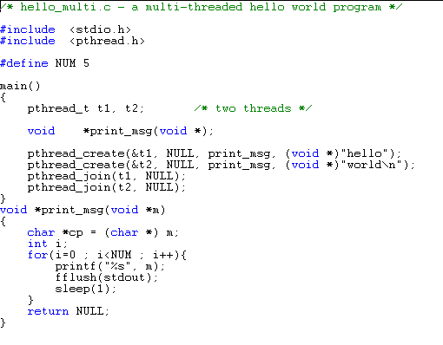
pthread_create

Slide 22
Windows tools to manage Process and Thread
Built-in tools in Windows
Task Manager, Performance Tool
Tasklist command
Tools from www.sysinternals.com
Process Monitor – super Task Manager – shows open files, loaded DLLs, security info, etc.
Pslist – list processes on local or remote systems
Ntpmon - shows process/thread create/deletes
(and context switches on MP systems only)
Listdlls - displays full path of EXE & DLLs loaded in each process
Notes:
A number of tools for viewing (and modifying) processes and process information are available. These tools are included within Windows itself and within the Windows Support Tools, Windows Debugging Tools, Windows resource kits, the Platform SDK, and from www.sysinternals.com. Many of these tools show overlapping subsets of the core process and thread information, sometimes identified by different names.

Slide 23
References
Silberschatz, Galvin and Gagne, Operating System Concepts with Java, John Wiley & Sons, latest edition.
Chapter 6 – Process Scheduling and Threads
Thread priorities
Thread Synchronization

